Slide 1
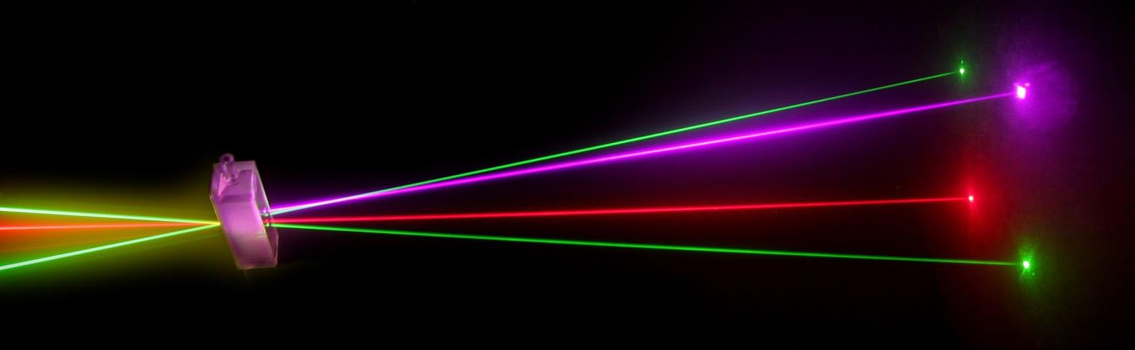
“Laser Technology and Applications” 16B1NPH533 Lecture 16-17

Slide 2
Lecture 16-17 Content Outlines
Level Broadening
Lineshape Function
Natural Linewidth
Collision Broadening
Doppler Broadening

Slide 3
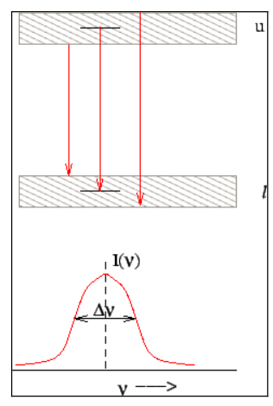
Level Broadening:
Atomic energy levels are not infinitely sharp but have some width associated with them. As a result, the spectrum of transition is not sharp lines but have some distribution. For instance, the emission spectrum for transition from E_{upper} to E_{lower} is a bell shaped curve

Slide 4
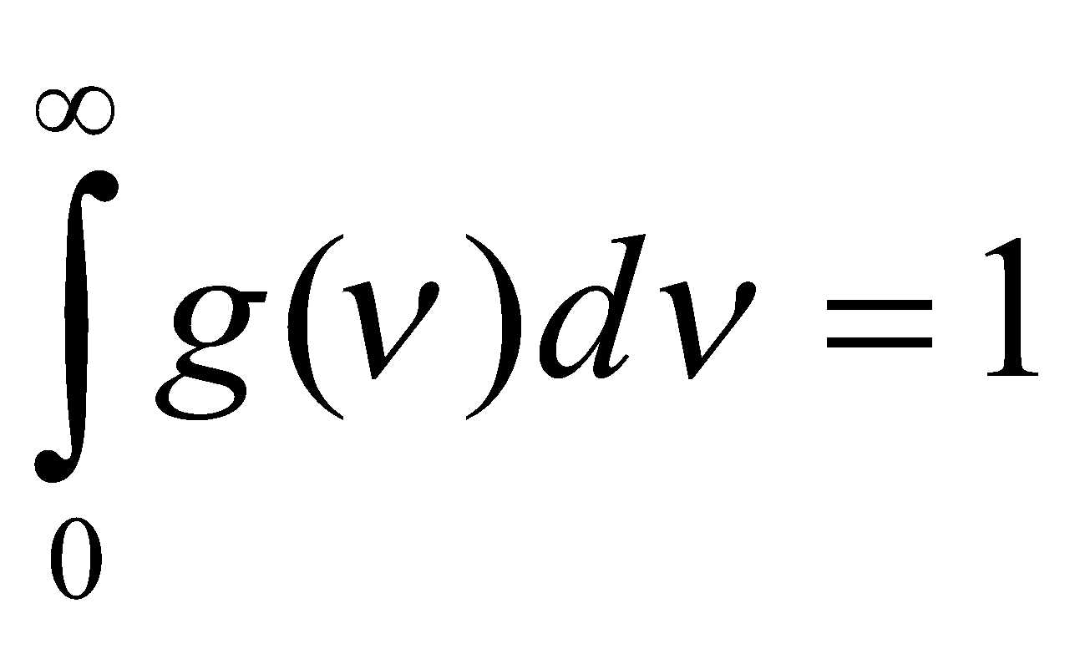
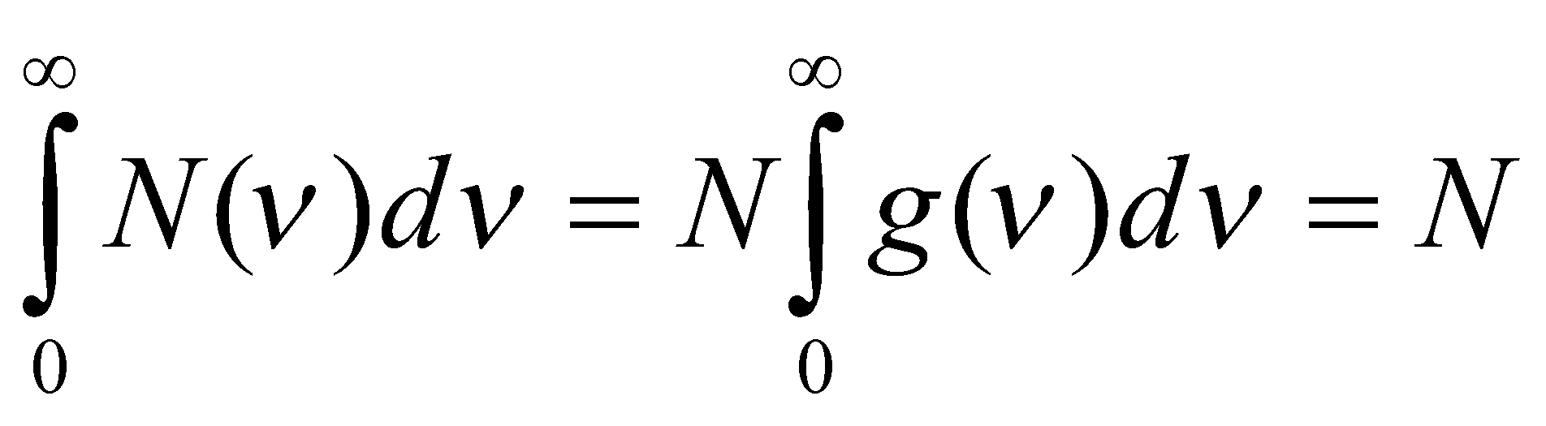
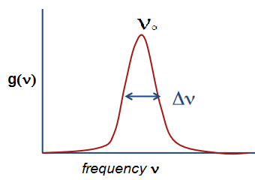
Lineshape Function :
Lineshape function g(ν) such that g(ν)dν the probability that a transition between two levels is an emission (or absorption) of photon whose frequency lies in the range ν and ν+dν . Normalization demands
If N is the number of atoms in a given energy level, the spectral distribution of population in the level is given by N(ν)=g(ν)N , i.e. N(ν)dν is the number of atoms in the levels within frequency range ν and ν+dν , so that
g(ν) is a complicated function which depends on the transition involved and also on external factors.
The study of line broadening is extremely important since it determines the operation characteristics of the laser such as threshold population inversion and the number of oscillating modes etc.

Slide 5
The broadening of spectral lines is classified into two major categories :
Homogeneous Broadening :
In homogeneous broadening all atoms interact identically with the radiation field so that each atom makes the same transition with identical lineshape and width. Two of the prominent causes of homogeneous broadening are natural line broadening and collision broadening. Other sources of homogeneous broadening are dipolar broadening arising out of interactions between electric and magnetic fields of neighboring atoms and thermal broadening due to effects of lattice vibrations on atomic transitions.
Inhomogeneous Broadening:
In inhomogeneous broadening, different atoms interact differently with the radiation field. Doppler broadening due to thermal motion of atoms and broadening due to crystalline homogeneities belong to this category.

Slide 6

Natural Linewidth :
Natural linewidth is an inherent width associated with any energy level due to quantum mechanical uncertainty principle. According to this principle, if is the minimum certainty in the lifetime of an atom in an energy level, the uncertainty in determining the energy level itself is given by
ΔE Δt ≥ h/2π
Using , E=hν , the relation may be written as
Δν Δt ≥ 1/2π
Thus in a two level system, there is an width associated with both the upper and lower levels. This, in turn, implies that there is an inherent width in the frequency of photons emitted due to the transition. In a typical transition, the excited state lifetime is seconds. The corresponding linewidth is about 16 MHz. The normalized lineshape function for the Natural broadening is referred to as a Lorentzian.

Slide 7
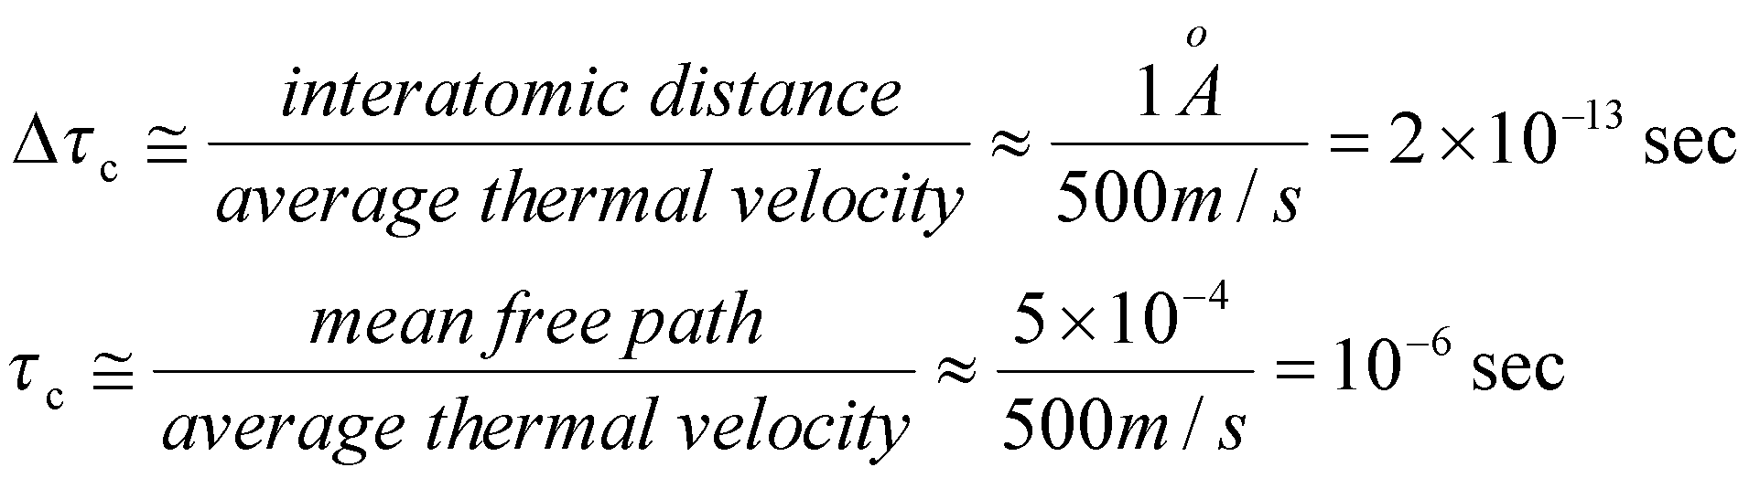
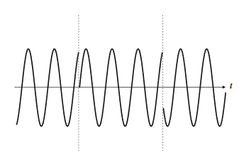

Collision broadening
Collision broadening is due to the random collision occurring between the atoms in a gas. If τ_{c} is the time between collision and delta Δτ_{c} is a collision time then
Since the collision time Δτ_{c} is random, the phase of the wave after the collision is arbitrary with respect to the phase before collision. Thus after is collision there is a random phase change of atoms and so the wave is no longer monochromatic. The lineshape function for collision broadening will a Lorentzian.

Slide 8

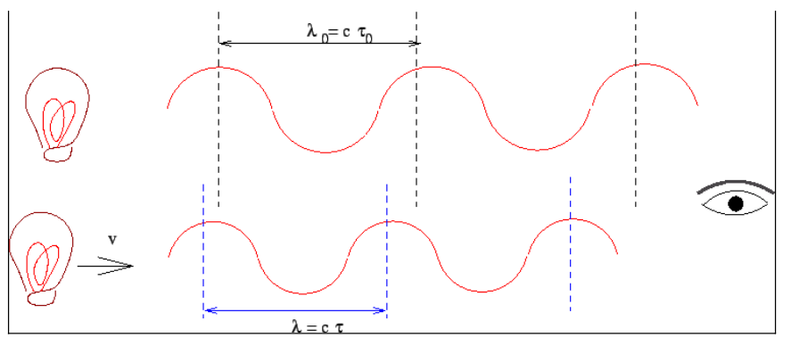
Doppler broadening:
In this case group and atoms having different velocity components are distinguishable and have different spectral responses. In a gas, atoms move randomly and when a moving atom interacts with the EM radiation the apparent frequency of the wave is different from that seen from the stationary atom this is called Doppler Effect and the broadening caused by this is known as Doppler broadening. Lineshape function of Doppler Broadening corresponds to a Gaussian distribution.
ν= ν_{o}(1-v_{x}/c)

Slide 9
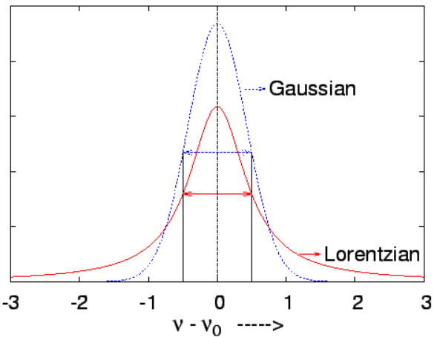
a comparative plot of a Lorentzian and a Gaussian line having the same FWHM. It can be seen that the peak value of the Gaussian is more and that the Lorentzian has a much longer tail.
Lorentzian functions
Natural Broadening
Colllision Broadening
Gaussian Function
Doppler effect

